Slide 1
Pre-Project Presentation Estimation of Object Dimension using Image Processing Programme: B. Tech in CSE
Mentor(s) : Mr. Prakash P, Pallavi R
Group No. : 14
Team Leader : Shridhar Hegde
Department : Computer Science and Engineering

Slide 2
Project Team
Sl no. | Registration no. | Students
1. | 16ETCS002122 | Shivakumar M
2. | 16ETCS002124 | Shridhar Hegde
3. | 16ETCS002112 | Santosh G
4. | 16ETCS002116 | Sai Bharadwaj

Slide 3
Outline
Motivation/Need for study
Title and Aim
Objectives
Methods and Methodology
Expected Outcomes
Cost Estimation
Gantt Chart
Work load allocation
References

Slide 4
Motivation/Introduction
Computing has become so inexpensive that everyone carries a camera enabled computer in their pocket (cellphones)
Engineers and Scientists constantly build physical scientific models & need to ascertain it’s dimensions
It is cumbersome to carry around standard measuring instruments
Applying the knowledge of Image Processing can solve this problem if one can obtain the pictures of the objects customarily using cellphone camera

Slide 5
Title
Development of a system to estimate object dimensions using image processing

Slide 6
Aim
To develop a system to estimate the dimensions of a given object using Image Processing techniques

Slide 7
Objectives
To conduct literature survey on image processing, depth and geometry prediction using triangulation
To analyze the literature survey and derive the requirements for building software to find the dimensions of an object in an image
To design a mathematical model for depth analysis and to measure dimensions of an object

Slide 8
Objectives cont…
To implement the designed mathematical model using appropriately chosen programming languages and tools
To test and validate the software built for different cases considered and incorporate necessary changes
To document the report by unifying all the results and outcomes

Slide 9
Methods and Methodology
To conduct literature survey on
1.1: Parallax method to compute the dimensions of object
when the viewpoint changes
1.2: Reference object method, scale of a reference object to
compute the dimensions of the object
1.3: Image pre-processing and processing, Object
segmentation in an image

Slide 10
Methods and Methodology cont..
To analyze the literature survey and finding the requirements
2.1: Compare different methods found in the literature
survey to find the dimensions of the object in an
image
2.2: Based on the analysis, find the functional and non-
functional requirements
2:3 Check feasibility for the identified requirements

Slide 11
Methods and Methodology cont..
To design and implement a mathematical model for depth analysis and to measure dimensions of an object
3.1: A high-level block diagram is designed to identify
primary functionalities of the software
3.2: A mathematical model to compute the dimensions
from a theoretical aspect is built
3.3: A low-level block diagram is then designed to
represent the functions that inputs an image,
processes the image, separates the object from
background and outputs the dimensions of the object

Slide 12
Methods and Methodology cont..
To develop software which can predict/compute the dimensions for a given image as input
4.1: Identify the appropriate programming language and tools
(mostly free and/or open source) to use based on the
design and requirements
4.2: Develop a software that accepts an image as input,
processes it, identifies various objects in it, compute and
returns the dimensions of the object

Slide 13
Methods and Methodology cont..
To test and validate the software built for different cases considered and incorporate necessary changes
5.1: The software built will be tested for different cases and
find exceptions and anomalies
5.2: Unit test, integration and functional tests will be made to
ensure the product works well in different layers/levels
5.3: Comparison is made between the actual dimensions of an
object and the dimensions given by the software
5.4: The errors and the functionality test case failures (if any)
are identified and changes are incorporated

Slide 14
Methods and Methodology cont..
To document the report by unifying all the results and outcomes
6.1: A report will be made illustrating the need for the
project, introduction of the project and the related works
in this domain so far
6.2: The various designs made, implementation, testing and
results are reported
6.3: Demonstrate the working of the product built with
sample image as input to the software
6.4: The performance is compared with other existing models
and efficiency, error rate is reported

Slide 15
Expected Outcomes
Demonstration of Working Model
The demo of the program is given to the mentor and the project review panel
Report generation
Final report is drafted which explains the whole story behind the product
Publishing the project in reputed journals
The project is presented to reputed journals and universities

Slide 16
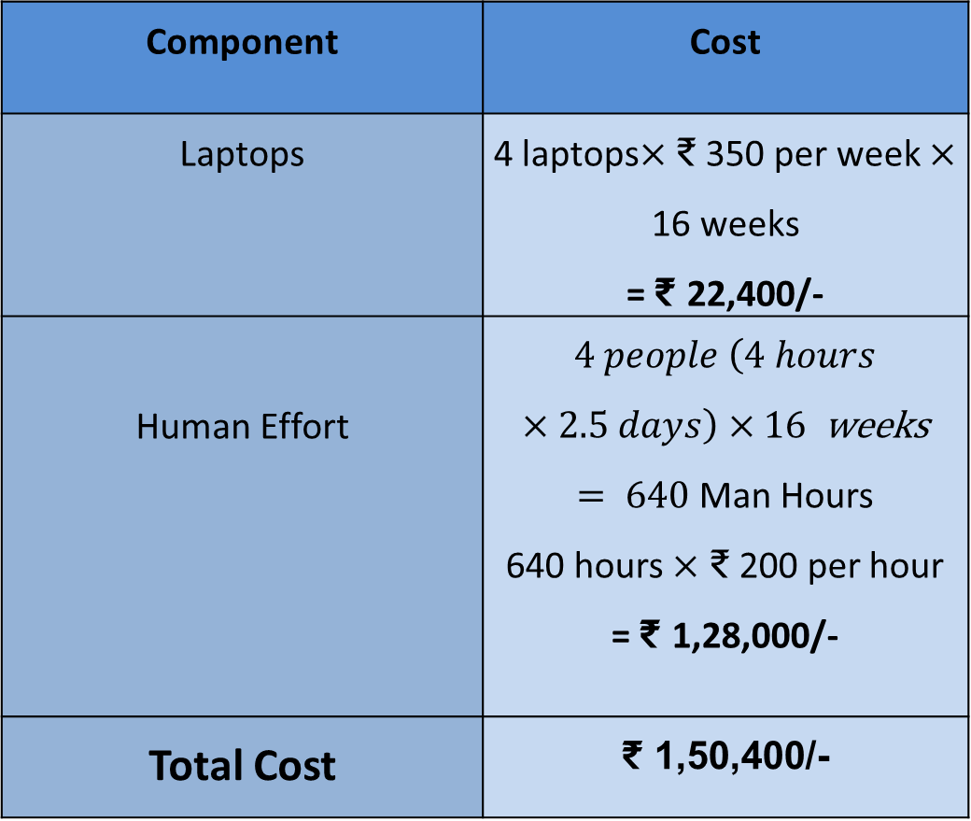
Cost Estimation
Component | Cost
Laptops | 4 laptops$×$ ₹ 350 per week $×$ 16 weeks = ₹ 22,400/-
Human Effort | $4 people \left(4 hours×2.5 days\right)×16$ weeks $= 640$ Man Hours 640 hours $×$ ₹ 200 per hour = ₹ 1,28,000/-
Total Cost | ₹ 1,50,400/-

Slide 17
Gantt Chart
Project Work (UG) 16 weeks
Week | 1 | 2 | 3 | 4 |  | 5 | 6 |  | 7 |  | 8 | 9 |  | 10 | 11 | 12 | 13 | 14 | 15 | 16
Major Activities
Literature survey
Design
Implementation
Testing
Validation
Documentation

Slide 18
Work Load Allocation
 | Shivakumar M | Shridhar Hegde | Santosh G | Segu Sai Bharadwaj
Literature Survey
Documentation
Requirements analysis
Designing
Implementation
Testing
Performance Analysis

Slide 19
References
Ali, Yasir & Malik, Aamir. (2012). Depth and Geometry from a Single 2D Image Using Triangulation. Proceedings of the 2012 IEEE International Conference on Multimedia and Expo Workshops, ICMEW 2012. 511-515. 10.1109/ICMEW.2012.95.
Adrian Rosebrock (2016). Measuring size of objects in an image with OpenCV[Online]. Available at: https://www.pyimagesearch.com/2016/03/28/measuring-size-of-objects-in-an-image-with-opencv/ (Accessed: 5th February 2019)

Slide 20
References cont..
A. Criminisi, I. Reid, and A. Zisserman, “Single View Metrology,” International Journal of Computer Vision, vol. 40, no. 2, pp. 123-148, 2000.
Peng, K., Hou, L., Ren, R., Ying, X., & Zha, H. (2010). Single View Metrology Along Orthogonal Directions. 2010 20th International Conference on Pattern Recognition. doi:10.1109/icpr.2010.410

Slide 21
Thank You

